Slide 1

The Cortana Intelligence Suite
Focus – Microsoft R for Architects
Microsoft Machine Learning and Data Science Team
CortanaIntelligence.com
Notes:
Main page: http://cortanaanalytics.com
To begin this module, you should have:
Basic Math and Stats skills
Business and Domain Awareness
General Computing Background
NOTE: These workbooks contain many resources to lead you through the course, and provide a rich set of references that you can use to learn much more about these topics. If the links do not resolve properly, type the link address in manually in your web browser. If the links have changed or been removed, simply enter the title of the link in a web search engine to find the new location or a corollary reference.

Slide 2
Welcome!
Log in to the site:
http://cisw-foundations.azurewebsites.net/
Select the “CISR302 - Microsoft R (Architecture and Administration)” Link

Slide 3

Learning Objectives
Understand the R Language and where it is used
Understand the Microsoft R Platform and its capabilities
Set up and use the server and various client tools for a R environment
Know how to operationalize a SQL Server R Services environment
Use the Microsoft R capabilities in a solution
Notes:
At the end of this Course, you will:
Understand the R Language and where it is used
Understand the Microsoft R Platform and its capabilities
Set up and use the server and various client tools for a R environment
Know how to operationalize a SQL Server R Services environment
Use the Microsoft R capabilities in a solution

Slide 4

Class
Self-Study
Projects

Slide 5
The Data Science Process and Platform
Notes:
This process largely follows the CRISP-DM model: http://www.sv-europe.com/crisp-dm-methodology/

Slide 6
The Team Data Science Process
Business Understanding
Define Objectives
Identify Data Sources
Data Acquisition and Understanding
Ingest Data
Explore Data
Modeling
Feature Selection
Create and Train Model
Deployment
Customer Acceptance
Operationalize
Testing and Validation
Update Data
Handoff
Re-train and re-score
Notes:
It also references the Cortana Intelligence process: https://azure.microsoft.com/en-us/documentation/articles/data-science-process-overview/
A complete process diagram is here: https://azure.microsoft.com/en-us/documentation/learning-paths/cortana-analytics-process/
Some walkthrough’s of the various services: https://azure.microsoft.com/en-us/documentation/articles/data-science-process-walkthroughs/
An integrated process and toolset allows for a more close-to-intent deployment
Iterations are required to close in on the solution – but are harder to manageme and monitor
Data Science Blog: https://buckwoody.wordpress.com/

Slide 7
The Cortana Intelligence Platform
Cortana, Cognitive Services, Bot Framework
Power BI
HDInsight
Stream Analytics
Azure Machine Learning (MRS)
SQL Data Warehouse (SQL DB, Document DB)
Data Lake
Event Hubs
Data Factory
Data Catalog
Microsoft Azure
Notes:
Platform and Storage: Microsoft Azure – http://microsoftazure.com Storage: https://azure.microsoft.com/en-us/documentation/services/storage/ (Host It)
Azure Data Catalog: http://azure.microsoft.com/en-us/services/data-catalog (Doc It)
Azure Data Factory: http://azure.microsoft.com/en-us/services/data-factory/ (Move It)
Azure Event Hubs: http://azure.microsoft.com/en-us/services/event-hubs/ (Bring It)
Azure Data Lake: http://azure.microsoft.com/en-us/campaigns/data-lake/ (Store It)
Azure DocumentDB: https://azure.microsoft.com/en-us/services/documentdb/ , Azure SQL Data Warehouse: http://azure.microsoft.com/en-us/services/sql-data-warehouse/ (Relate It)
Azure Machine Learning: http://azure.microsoft.com/en-us/services/machine-learning/ (Learn It)
Azure HDInsight: http://azure.microsoft.com/en-us/services/hdinsight/ (Scale It)
Azure Stream Analytics: http://azure.microsoft.com/en-us/services/stream-analytics/ (Stream It)
Power BI: https://powerbi.microsoft.com/ (See It)
Cortana: http://blogs.windows.com/buildingapps/2014/09/23/cortana-integration-and-speech-recognition-new-code-samples/ and https://blogs.windows.com/buildingapps/2015/08/25/using-cortana-to-interact-with-your-customers-10-by-10/ and https://developer.microsoft.com/en-us/Cortana (Say It)
Cognitive Services: https://www.microsoft.com/cognitive-services
Bot Framework: https://dev.botframework.com/
All of the components within the suite: https://www.microsoft.com/en-us/server-cloud/cortana-intelligence-suite/what-is-cortana-intelligence.aspx
What can I do with it? https://gallery.cortanaintelligence.com/
Getting Started Quickly: https://caqs.azure.net/#gallery

Slide 8
The R Programming Environment
Notes:
Video Introduction to R: https://mran.revolutionanalytics.com/documents/what-is-r/

Slide 9

R Programing and Environment
Open Source “lingua franca”
Global Community
Ecosystem
Can be Scaled to Big Data,
Big Analytics
Analytics, Computing, Modeling
Millions of users
7000+ Algorithms, Test Data & Evaluations
Scalability
Notes:
R In Youtube: https://www.youtube.com/user/thelearnr
R Links: http://www.datasciencecentral.com/m/discussion?id=6448529%3ATopic%3A280135
R resources: https://msdn.microsoft.com/en-us/microsoft-r/microsoft-r-more-resources

Slide 10
SQL
SQL and R Contrasted
R
Client/Server
Database Objects
DML, DDL
DCL
Declarative Code
Interactive Environment
Data Structures
Functions
Libraries (Packages)
Functional Code Flow
Notes:
Learn SQL: http://www.w3schools.com/SQl/default.asp
Try R, with a great interface. http://tryr.codeschool.com/levels/1/challenges/22
R and Statistics Intro: https://www.youtube.com/watch?v=xb5P5xdcr2U&feature=youtu.be&a
R Online: http://www.tutorialspoint.com/r_terminal_online.php
Using R to explore data: http://www.analyticsvidhya.com/blog/2015/10/cheatsheet-11-steps-data-exploration-with-codes/
Quick R Intro: http://www.datasciencecentral.com/m/blogpost?id=6448529%3ABlogPost%3A112754
Creating a recommender engine in R: http://www.analyticbridge.com/profiles/blogs/build-basic-recommendation-engine-using-r
Visualizations cheat-sheet in R: http://www.datasciencecentral.com/forum/topics/cheat-sheet-data-visualization-with-r?groupUrl=tutorials
Data Science Blog: https://buckwoody.wordpress.com/

Slide 11
R Data Types
Numeric
Integer
Complex
Logical
Character
Notes:
Video Introduction to R: https://mran.revolutionanalytics.com/documents/what-is-r/
Working with R Data Types: https://msdn.microsoft.com/en-us/library/mt590948.aspx
Data Science Blog: https://buckwoody.wordpress.com/

Slide 12
R Data Structures
Vector
A single-line sequence of one datatype
List
An ordered collection of objects, allowing a variety of (possibly unrelated) objects under one name
Matrix
A multi-line sequence of the same length and datatype
Array
Like a Matrix, but with more dimensions
Notes:
R Data Structures from Advanced R by Hadley Wickham: http://adv-r.had.co.nz/Data-structures.html
Factors – https://www.tutorialspoint.com/r/r_factors.htm
Data Science Blog: https://buckwoody.wordpress.com/

Slide 13



Lab:
Account Activation/ VM Setup
Workstation Setup
R Tutorial
SQL Tutorial
Notes:
If you do not have a Microsoft Azure account, go here: https://azure.microsoft.com/en-us/free/ (You will need a credit card, but you will not be charged)
Log in to the Azure Portal: https://ms.portal.azure.com
Create a new Windows Data Science Virtual Machine (2 Processors, 7GB RAM, HDD): https://azure.microsoft.com/en-us/documentation/articles/machine-learning-data-science-vm-do-ten-things/
Optional, if using your local machine:
Install SQL Server 2016 and ensure you select R Services – see this link: https://www.microsoft.com/en-us/cloud-platform/sql-server-editions-developers
Install Visual Studio Community Edition 2015: https://www.microsoft.com/en-us/download/details.aspx?id=48146
Install SQL Server Data Tools: https://docs.microsoft.com/en-us/sql/ssdt/download-sql-server-data-tools-ssdt
Install R Tools for Visual Studio: https://microsoft.github.io/RTVS-docs/
For R, Open this site, complete the lessons the instructor assigns: http://tryr.codeschool.com/
For SQL, Open this site, complete the lessons the instructor assigns: http://www.w3schools.com/SQl/default.asp
For Advanced R, complete this series: https://www.datacamp.com/community/open-courses/big-data-revolution-r-enterprise-tutorial#gs.rRVTAa4

Slide 14
The Microsoft R Platform
Notes:
Primary Microsoft R Site: https://msdn.microsoft.com/en-us/microsoft-r/index

Slide 15
Microsoft R Products
Microsoft R Open
SQL Server R Services
Free and open source R distribution
Built in Advanced Analytics and Stand Alone Server Capability
Enhanced and distributed by Revolution Analytics
Leverages the Benefits of SQL 2016 Enterprise Edition
Microsoft R Server for Redhat Linux
Microsoft R Server for SUSE Linux
Microsoft R Server for Teradata DB
Microsoft R Server for Hadoop on Redhat
Microsoft R Server
Notes:
Channel 9 videos on Microsoft R: https://channel9.msdn.com/Search?term=Microsoft%20R#lang-en=en&ch9Search

Slide 16

Microsoft R Open
Enhanced Open Source R distribution
Based on the latest Open Source R
Built, tested and distributed by Microsoft
Enhanced by Intel MKL Library to speed up linear algebra functions
Compatible with all R-related software
CRAN packages, RStudio, third-party R integrations, …
Revolutions Open-Source R packages
Reproducible R Toolkit – checkpoint
MRAN website mran.revolutionanalytics.com
Enhanced documentation and learning resources
Discover 7500 free add-on R packages
Open source (GPLv2 license) - 100% free to download, use and share
Notes:
Quick Video on R Client: https://channel9.msdn.com/blogs/MicrosoftR/Microsoft-Introduces-new-free-Microsoft-R-Client

Slide 17
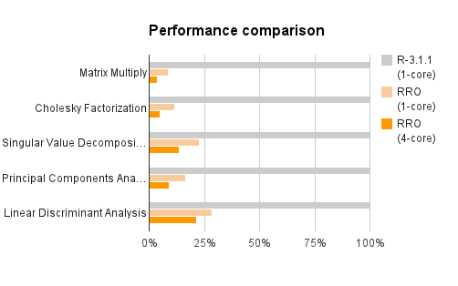
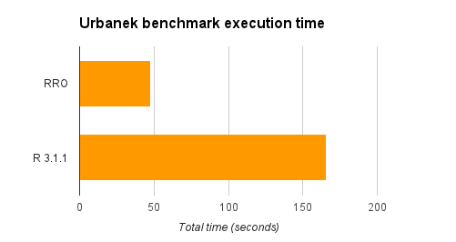
CRAN R compared to Microsoft R Open
Matrix calculation – up to 27x faster
Matrix functions – up to 16x faster
Programation – 0x faster
More efficient and multi-threaded math computation.
Benefits math intensive processing.
No benefit to program logic and data transform
Notes:
Overview: https://channel9.msdn.com/Series/Microsoft-R-Server-Series/Introduction-to-Microsoft-R-Server-Session-1--Overview

Slide 18
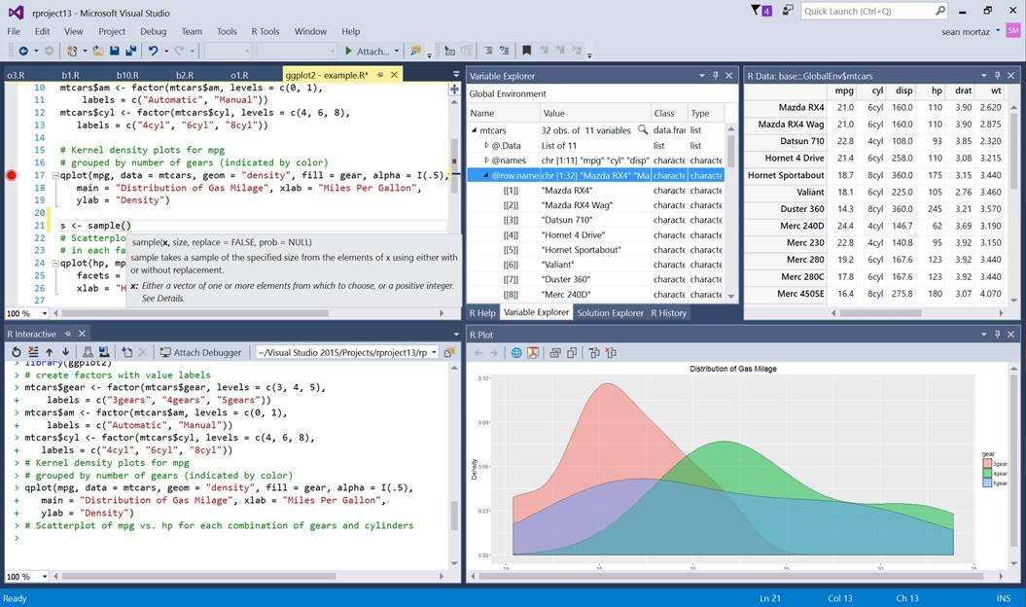
Microsoft R Open and R Client
Microsoft R Server
ScaleR
Notes:
Book and Series: http://dacrook.com/introduction-to-microsoft-r-open/
Microsoft R Client: https://msdn.microsoft.com/en-us/microsoft-r/index#mrc
Data Science Blog: https://buckwoody.wordpress.com/

Slide 19
Microsoft R Components
Microsoft R Open
Microsoft R Client
Microsoft R Server
HDInsight SparkR / SQL Server R Services
R in Azure Machine Learning
Notes:
Supported Platforms for Microsoft R Server: https://msdn.microsoft.com/en-us/microsoft-r/rserver-install-supported-platforms
Book and Series: http://dacrook.com/introduction-to-microsoft-r-open/
Microsoft R Client: https://msdn.microsoft.com/en-us/microsoft-r/index#mrc
Microsoft R Server: https://msdn.microsoft.com/en-us/microsoft-r/index#mrs
SQL Server R Services: https://msdn.microsoft.com/en-us/microsoft-r/index#sqlr
HDInsight SparkR: https://azure.microsoft.com/en-gb/services/hdinsight/apache-spark/
Data Science Blog: https://buckwoody.wordpress.com/

Slide 20
Microsoft R Server
Microsoft R Server is a broadly deployable enterprise-class analytics platform based on R that is supported, scalable and secure. Supporting a variety of big data statistics, predictive modeling and machine learning capabilities, R Server supports the full range of analytics – exploration, analysis, visualization and modeling
High-performance open source R plus:
Data source connectivity to big-data objects
Big-data advanced analytics
Multi-platform environment support
Inpredictive modeling
Development and production environment support
IDE for data scientist developers
Secure, Scalable R Deployment
R Open
R Server
DeployR
ConnectR
DevelopR
R+CRAN
RSR Connector
ScaleR
DistributedR
Open Source Components
Licensed Components
Notes:
Microsoft R Server: https://msdn.microsoft.com/en-us/microsoft-r/index#mrs

Slide 21
The Microsoft R Server Platform
R+CRAN
Open source R interpreter
R 3.2.2
Freely-available huge range of R algorithms
Algorithms callable by MSR
Embeddable in R scripts
100% Compatible with existing R scripts, functions and packages
R Open Microsoft R Server
DevelopR
ConnectR
ConnectR
High-speed & direct connectors
Available for:
High-performance XDF
SAS, SPSS, delimited & fixed format text data files
Hadoop HDFS (text & XDF)
Teradata Database & Aster
EDWs and ADWs
ODBC
DeployR
R+CRAN
RSR Connector
ScaleR
DistributedR
ScaleR
Ready-to-Use high-performance big data big analytics
Fully-parallelized analytics
Data prep & data distillation
Descriptive statistics & statistical tests
Range of predictive functions
User tools for distributing customized R algorithms across nodes
Wide data sets supported – thousands of variables
MRO
Performance enhanced R interpreter
Based on open source R
Adds high-performance math library to speed up linear algebra functions
DistributedR
Distributed computing framework
Delivers cross-platform portability
Notes:
Installing on Linux: https://channel9.msdn.com/Series/Microsoft-R-Server/Microsoft-R-Server-Installation-Linux

Slide 22

CRAN, MRO, MRS Comparison
Microsoft
R Open
Microsoft
R Server
Datasize | In-memory | In-memory | In-Memory or Disk Based
Speed of Analysis | Single threaded | Multi-threaded | Multi-threaded, parallel processing 1:N servers
Support | Community | Community | Community + Commercial
Analytic Breadth & Depth | 7500+ innovative analytic packages | 7500+ innovative analytic packages | 7500+ innovative packages + commercial parallel high-speed functions
License | Open Source | Open Source | Commercial license. Supported release with indemnity
Notes:
Technology Overview: https://channel9.msdn.com/Series/Microsoft-R-Server/Technology-Overview-for-Microsoft-R-Server-2016

Slide 23

CRAN R
MRO
MRS
Adds multithreaded computation for linear algebra
MRS Packages
doRSR
RevoIOQ
RevoMods
RevoPemaR
RevoRpeConnector
RevoRsrConnector
RevoScaleR
RevoTreeView
RevoUtils
Adds functions and infrastructure for scalable computation over local and distributed platforms
Makes it easy to share R code and replicate results using specific R package versions.
MRO Packages
checkpoint (also on CRAN)
RevoUtilsMath (for MKL)
MRO Packages
checkpoint (also on CRAN)
RevoUtilsMath (for MKL)
Standard Packages
base
recommended
Standard Packages
base
recommended
Standard Packages
base
recommended
BLAS / LAPACK - Standard
BLAS / LAPACK – Intel MKL
BLAS / LAPACK – Intel MKL
Kernel
Kernel
Kernel
Notes:
Getting Started: https://msdn.microsoft.com/en-us/microsoft-r/?f=255&MSPPError=-2147217396

Slide 24
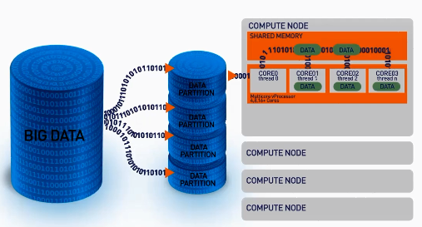
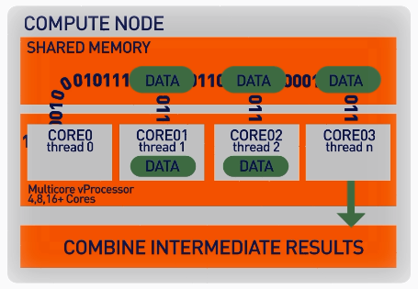
ScaleR – Parallel + “Big Data”
ScaleR algorithms work inside multiple cores / nodes in parallel at high speed
Stream data in to RAM in blocks. “Big Data” can be any data size. Handle Megabytes to Gigabytes to Terabytes…
Interim results are collected and combined analytically to produce the output on the entire data set
XDF file format is optimised to work with the ScaleR library and significantly speeds up iterative algorithm processing.
Notes:
Function Breakdown: https://msdn.microsoft.com/en-us/microsoft-r/scaler/scaler

Slide 25

Scale R – Parallelized Algorithms & Functions
Data Preparation
Statistical Tests
Variable Selection
Data import – Delimited, Fixed, SAS, SPSS, OBDC
Variable creation & transformation
Recode variables
Factor variables
Missing value handling
Sort, Merge, Split
Aggregate by category (means, sums)
Chi Square Test
Kendall Rank Correlation
Fisher’s Exact Test
Student’s t-Test
Stepwise Regression
Simulation
Sampling
Simulation (e.g. Monte Carlo)
Parallel Random Number Generation
Subsample (observations & variables)
Random Sampling
Cluster Analysis
Descriptive Statistics
Predictive Models
Min / Max, Mean, Median (approx.)
Quantiles (approx.)
Standard Deviation
Variance
Correlation
Covariance
Sum of Squares (cross product matrix for set variables)
Pairwise Cross tabs
Risk Ratio & Odds Ratio
Cross-Tabulation of Data (standard tables & long form)
Marginal Summaries of Cross Tabulations
K-Means
Sum of Squares (cross product matrix for set variables)
Multiple Linear Regression
Generalized Linear Models (GLM) exponential family distributions: binomial, Gaussian, inverse Gaussian, Poisson, Tweedie. Standard link functions: cauchit, identity, log, logit, probit. User defined distributions & link functions.
Covariance & Correlation Matrices
Logistic Regression
Classification & Regression Trees
Predictions/scoring for models
Residuals for all models
Classification
Decision Trees
Decision Forests
Gradient Boosted Decision Trees
Naïve Bayes
Combination
rxDataStep
rxExec
PEMA-R API Custom Algorithms
Notes:
SQL Server Implementation of ScaleR Functions: https://msdn.microsoft.com/en-us/library/mt652103.aspx

Slide 26
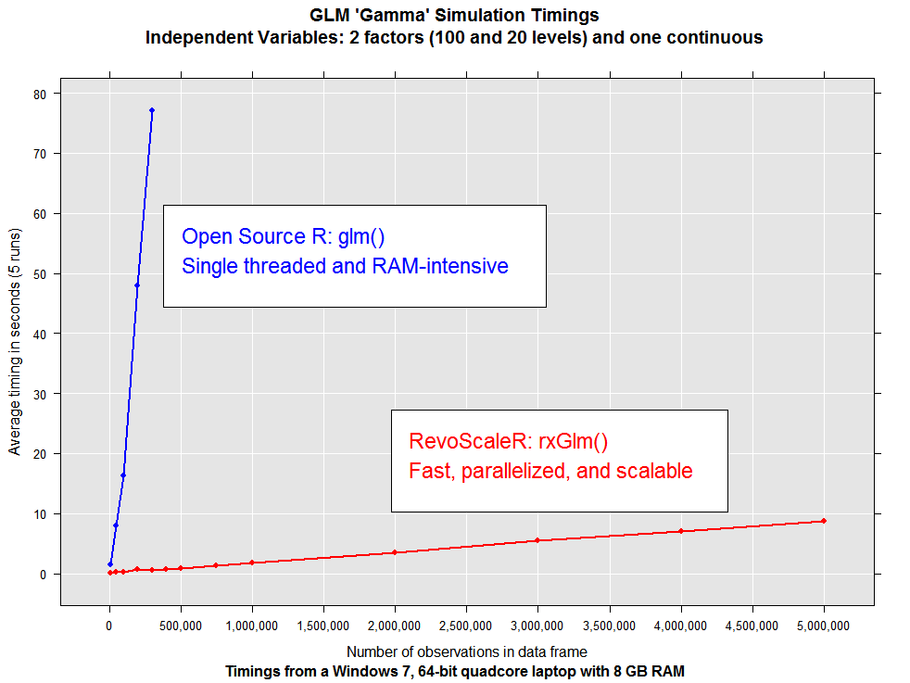
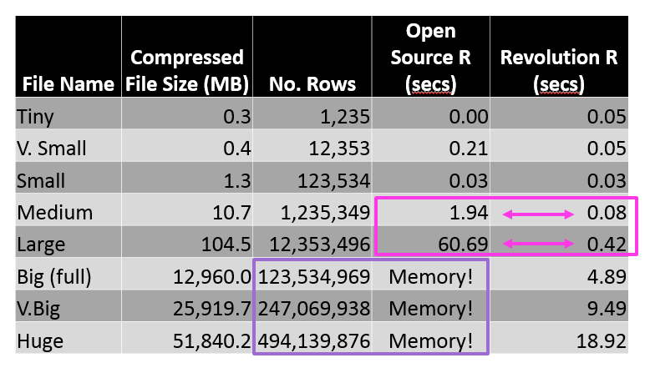
ScaleR - Performance comparison
Microsoft R Server has no data size limits in relation to size of available RAM. When open source R operates on data sets that exceed RAM it will fail. In contrast Microsoft R Server scales linearly well beyond RAM limits and parallel algorithms are much faster.
US flight data for 20 years
Linear Regression on Arrival Delay
Run on 4 core laptop, 16GB RAM and 500GB SSD
Notes:
ScaleR Functions for Working with SQL Server Data: https://msdn.microsoft.com/en-us/library/mt732681.aspx

Slide 27
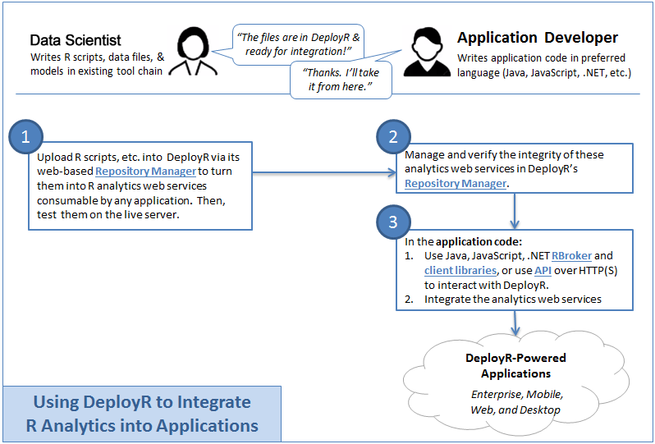
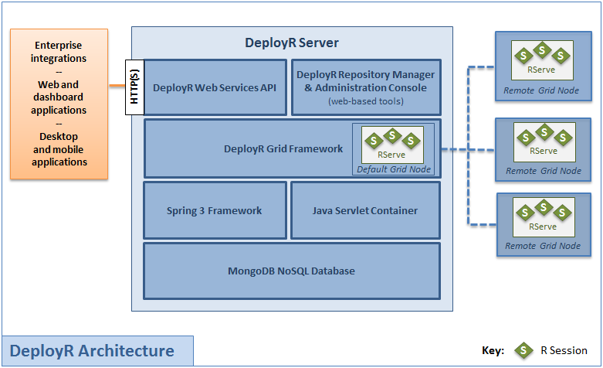
DeployR
Notes:
Microsoft DeployR Documentation: https://msdn.microsoft.com/en-us/microsoft-r/deployr-about
Previous Documentation: https://deployr.revolutionanalytics.com/documents/getting-started/about/
Data Science Blog: https://buckwoody.wordpress.com/

Slide 28
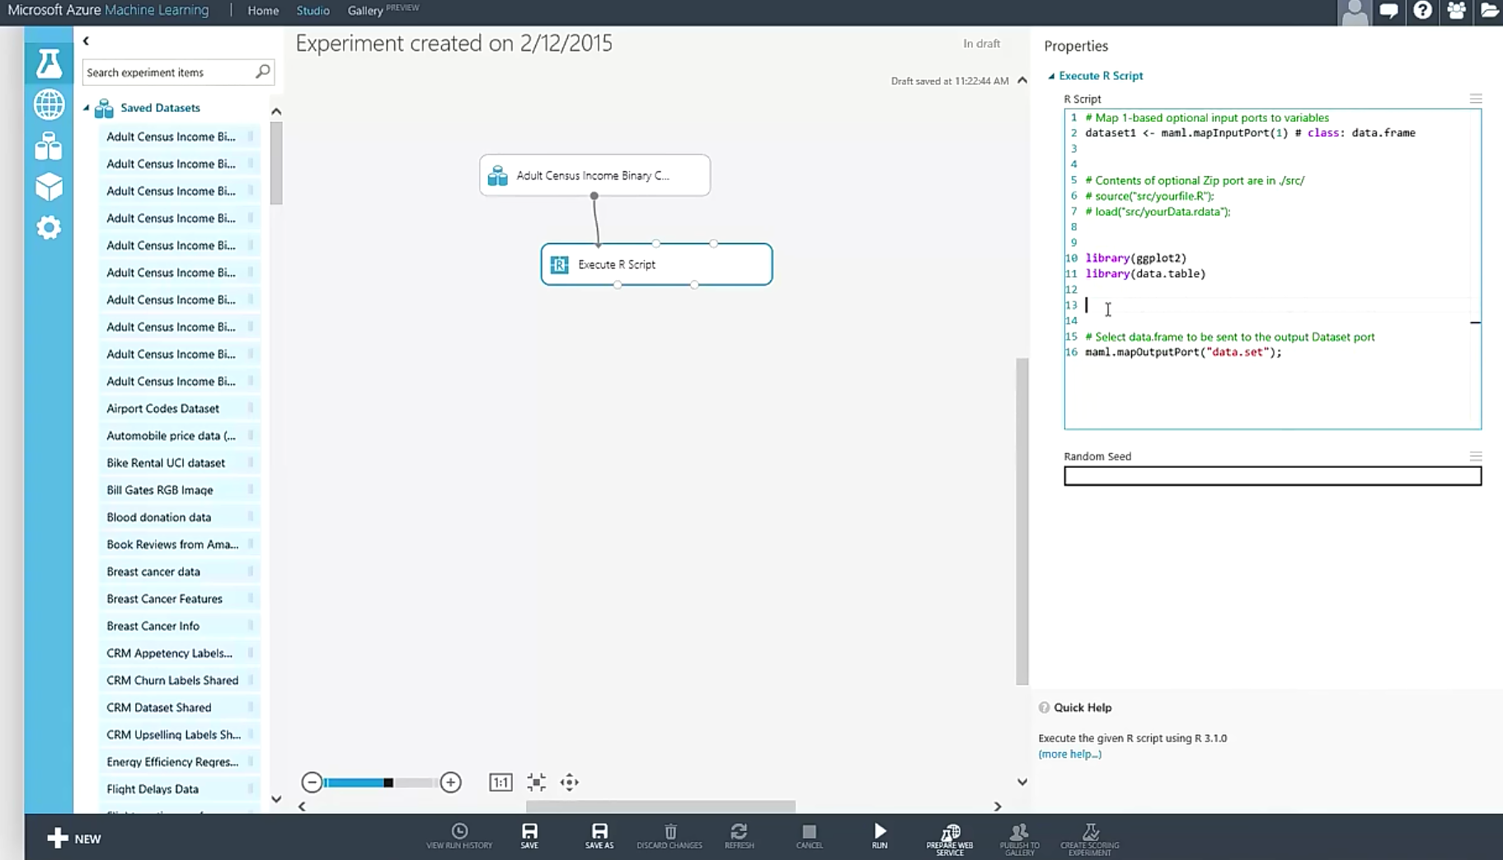
R in Azure Machine Learning
Dataset1 <-maml.mapInputPort(1) # class:data.frame
Notes:
Primary reference: https://msdn.microsoft.com/en-us/library/dn905952.aspx
Using R in Azure Machine Learning: https://azure.microsoft.com/en-us/documentation/articles/machine-learning-r-quickstart/
Overview Video: https://channel9.msdn.com/Blogs/Windows-Azure/R-in-Azure-ML-Studio
R Packages supported: https://msdn.microsoft.com/en-us/library/mt741980.aspx
Data Science Blog: https://buckwoody.wordpress.com/

Slide 29
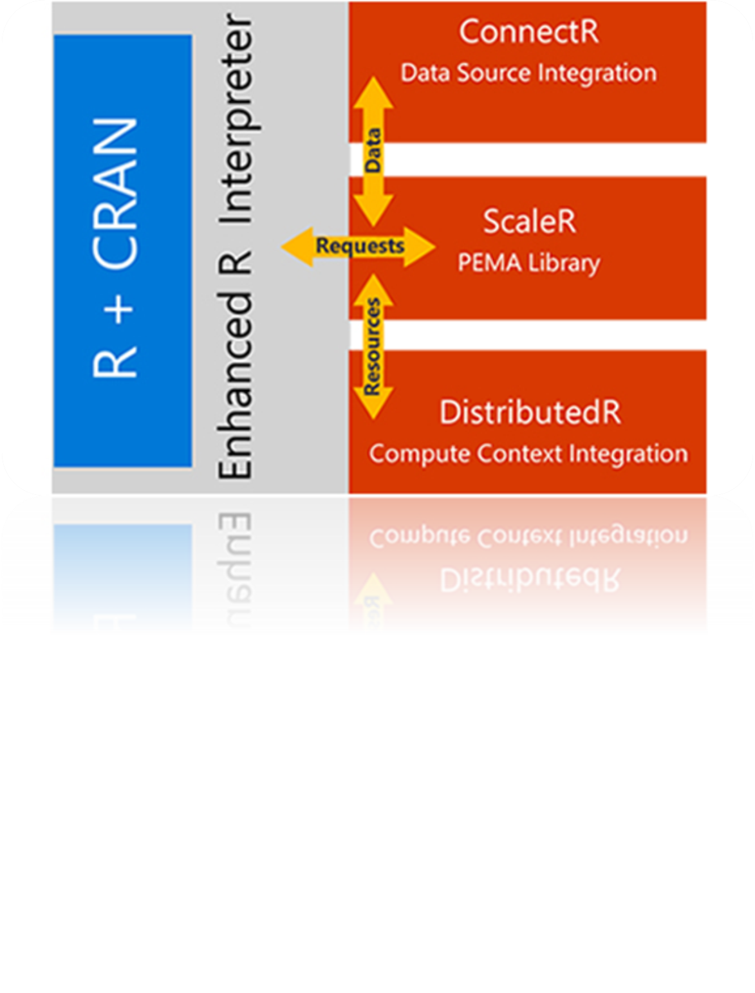
R in Spark HDInsight Cluster
Core Hadoop
Data processing
Microsoft integration
Data Movement
Packages
Pipeline / workflow
(Oozie)
JavaScript
C#, F#, .NET
(Zoo)
SparkR
Data Integration
(ODBC / SQOOP/ REST)
Relational
(SQL Server)
Metadata
(HCatalog)
PDW Polybase
Real Time Processing (Storm)
NoSQL Database
(HBase)
Scripting
(Pig)
Query
(Hive)
Event Driven Processing
Distributed Processing
(MapReduce)
Event Pipeline
(Event Hub/ Flume)
Business Intelligence
(Excel, Power View, SSAS)
YARN
Distributed Storage (HDFS)
Monitoring & Deployment (System Center)
World's Data (Azure Data Marketplace)
Azure Storage Vault (ASV)
Active Directory (Security)
Notes:
Full training example for the local HDP Instance: http://hortonworks.com/hadoop-tutorial/hello-world-an-introduction-to-hadoop-hcatalog-hive-and-pig/
More detail on the Hadoop Components: http://www.datasciencecentral.com/profiles/blogs/hadoop-herd-when-to-use-what

Slide 30

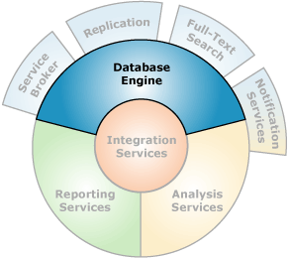
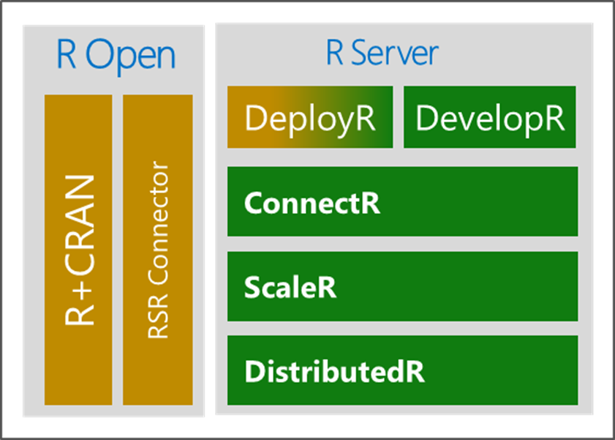

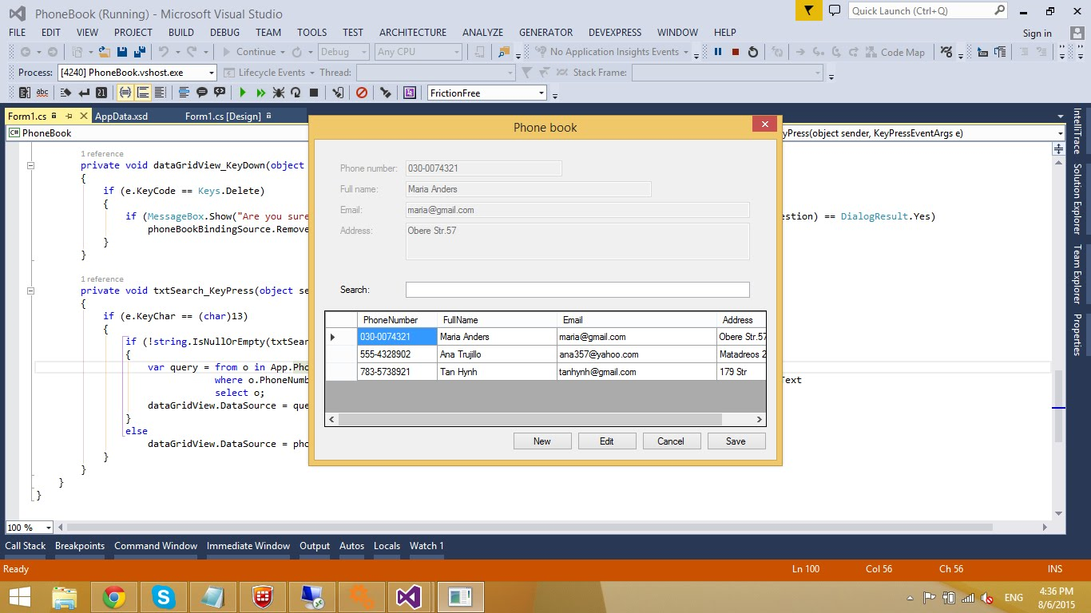
Microsoft R in SQL Server
Microsoft R Server
Launchpad
(BxlServer and SQL Satellite, Rserver.dll)
Notes:
Primary Documentation and training: https://msdn.microsoft.com/en-us/library/mt604845.aspx
Great set of resources: https://www.r-bloggers.com/r-and-sql-server-articles/amp/
Data Science Blog: https://buckwoody.wordpress.com/

Slide 31
Lab:
Install and Configure R Environments
Notes:
Read the installation page for MRS – https://msdn.microsoft.com/en-us/microsoft-r/rserver-install-supported-platforms
As assigned: Install Microsoft R Client - https://msdn.microsoft.com/en-us/microsoft-r/install-r-client-windows
As assigned: Install MRS on Windows - https://msdn.microsoft.com/en-us/microsoft-r/rserver-install-windows?f=255&MSPPError=-2147217396
As assigned: Install MRS on Linux – note: MSDN account required: https://msdn.microsoft.com/en-us/microsoft-r/rserver-install-linux-server?f=255&MSPPError=-2147217396
As assigned: Install SQL Server 2016 and ensure you select R Services – see this link: https://www.microsoft.com/en-us/cloud-platform/sql-server-editions-developers
Find out if MRS is loaded: - Open an R Client Session (SQL, MRS, AML, etc) and run sessionInfo()

Slide 32
R Client Options
Notes:
The Microsoft R Client: https://msdn.microsoft.com/en-us/microsoft-r/install-r-client-windows

Slide 33
Microsoft R Development Tools
Command-Line
RStudio
R Tools for Visual Studio (RTVS)
SQL Server tools
Notes:
Installing Microsoft R Client on Windows: https://msdn.microsoft.com/en-us/microsoft-r/install-r-client-windows
Files located at: C:\Program Files\Microsoft\R Client\R_SERVER\bin
Data Science Blog: https://buckwoody.wordpress.com/

Slide 34
Lab:
Install and Configure Client Environments
Notes:
Optional: Install Visual Studio 2015 Community Edition (https://www.microsoft.com/en-us/download/details.aspx?id=48146 ) (Select Optional, and include SQL Server Data Tools)
Optional: Install RTVS (http://microsoft.github.io/RTVS-docs/installer.html)
Optional: Install Rstudio (https://www.rstudio.com/products/rstudio/download2/)
Connect to R in Visual Studio or Rstudio or Command line (C:\Program Files\Microsoft SQL Server\MSSQL13.MSSQLSERVER\R_SERVICES\bin>R.exe) , and Run Revo.version to ascertain MRS running
Open Visual Studio, and read through the walkthrough of the RTVS tools for SQL Server and R: https://microsoft.github.io/RTVS-docs/sqlserver.html

Slide 35
Operationalize Microsoft R
Notes:
Complete introduction: https://msdn.microsoft.com/en-us/microsoft-r/microsoft-r-getting-started
Data Exploration and Modeling with R: https://msdn.microsoft.com/en-us/library/mt590947.aspx

Slide 36
Configuration and Operation
Planning
Specific Environments
File Locations
Services and Background Processes
Package Management
DeployR Planning
Notes:
Features and Tasks: https://msdn.microsoft.com/en-us/library/mt590811.aspx
Differences in Features: https://msdn.microsoft.com/en-us/library/mt721284.aspx
Installing on VM’s: https://msdn.microsoft.com/en-us/library/mt748179.aspx
Setting up R Services: https://msdn.microsoft.com/en-us/library/mt696069.aspx

Slide 37
Distributed R - Write once, deploy multiple
+ HD Insights
+ Hadoop Spark
Hortonworks
Cloudera
MapR
Hadoop
EDW
Teradata
ConnectR
+ SQL Server v16
Microsoft R Server
DeployR
DevelopR
R+CRAN
RSR Connector
ScaleR
Workstations & Servers
Linux Windows
DistributedR
In the Cloud
Azure Marketplace
+ Azure ML
Code Portability Across Platforms
Notes:
DeployR Workflow: https://msdn.microsoft.com/en-us/microsoft-r/deployr-about

Slide 38
CRAN/Microsoft R Open And Databases
RODBC
Notes:
Book and Series: http://dacrook.com/introduction-to-microsoft-r-open/
Microsoft R Client: https://msdn.microsoft.com/en-us/microsoft-r/index#mrc
Data Science Blog: https://buckwoody.wordpress.com/

Slide 39
Microsoft R in SQL Server
Microsoft R Server
Launchpad
(BxlServer and SQL Satellite, Rserver.dll)
Notes:
Primary Documentation and training: https://msdn.microsoft.com/en-us/library/mt604845.aspx
Data Science Blog: https://buckwoody.wordpress.com/

Slide 40
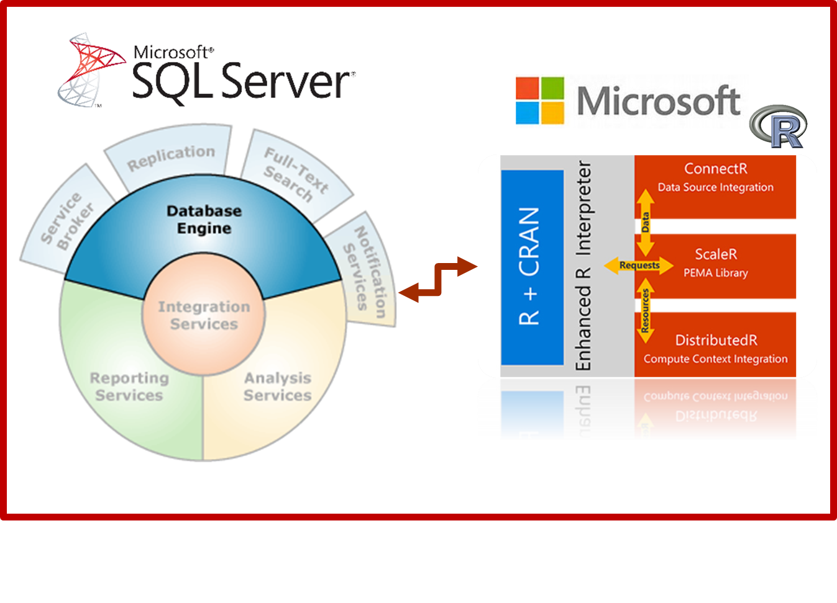
T-SQL and R Interaction
EXEC sp_execute_external_script
@language =N'R',
-- SQL Part (sends to @script)
@input_data_1 =N 'SELECT 1 as Installed',
-- R Part (gets @input_data_1)
@script=N'OutputDataSet<-InputDataSet'
WITH RESULT SETS
(([Installed] int not null));
GO
Notes:
Components and Architecture: https://msdn.microsoft.com/en-us/library/mt709082.aspx (with graphics)

Slide 41
Lab:
Check/Enable R Services in SQL Server
Notes:
From the Resources folder open the file R Services for SQL Server Lab.sql and run the section marked:
/* Check to see if R is Installed and available */

Slide 42
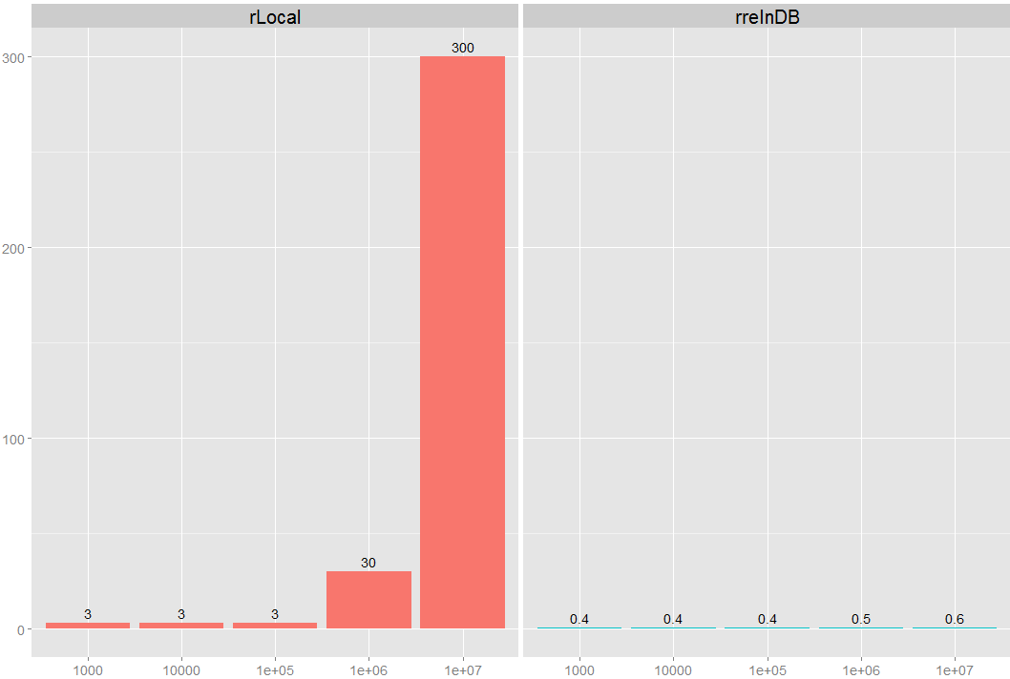
Example of In-Database Acceleration
5+ hours to 40 seconds:
R on a server pulling data via SQL
R on a server Invoking RRE ScaleR Inside the EDW
Minutes
rows

Slide 43
T-SQL and R Interaction
T-SQL Code
SELECT data
sp_execute_external_script
Launchpad (BxlServer and SQL Satellite, Rserver.dll)
R Data or Object Returns
Notes:
Components and Architecture: https://msdn.microsoft.com/en-us/library/mt709082.aspx (with graphics)

Slide 44
Lab:
Run R and T-SQL in SQL Server
Notes:
From the Resources folder open the file R Services for SQL Server Lab.sql and run the section marked:
/* Simple Example using internal R Data */

Slide 45
Performance and Monitoring
Performance considerations
Monitoring
Tuning
Notes:
Extended Events for SQL Server R Services: https://msdn.microsoft.com/en-us/library/mt628054.aspx

Slide 46
Lab:
Monitoring and Performance Tuning
Notes:
From the Resources folder open the file R Services for SQL Server Lab.sql and run the section marked:
/* Performance Tuning */

Slide 47
Security and Governance
Principals
Securables
Notes:
Security Overview: https://msdn.microsoft.com/en-us/library/mt709078.aspx

Slide 48
Lab:
Security and R Services for T-SQL
Notes:
From the Resources folder open the file R Services for SQL Server Lab.sql and follow along with the instructor for the section marked:
/* Security */

Slide 49
Packages
Use
Adding
Querying
Considerations
Notes:
Packages: http://www.dummies.com/programming/r/how-to-install-load-and-unload-packages-in-r/ and https://cran.r-project.org/doc/manuals/R-admin.html#Add_002don-packages
Book on Creating your own Packages: http://r-pkgs.had.co.nz/
A useful set of packages: https://support.rstudio.com/hc/en-us/articles/201057987-Quick-list-of-useful-R-packages
R Packages supported by Azure Machine Learning: https://msdn.microsoft.com/en-us/library/mt741980.aspx
R Package Management for SQL Server R Services: https://msdn.microsoft.com/en-us/library/mt790486.aspx
Scaling Packages: https://msdn.microsoft.com/en-US/library/mt637368.aspx
Data Science Blog: https://buckwoody.wordpress.com/

Slide 50
Lab:
Package Management in R and T-SQL
Notes:
From the Resources folder open the file R Services for SQL Server Lab.sql and follow along with the instructor for the section marked:
/* Packages */

Slide 51
Implementation Considerations
Coordinating with the R professional
Best Practices
Notes:
Managing and monitoring R Solutions for SQL Server: https://msdn.microsoft.com/en-us/library/mt590866.aspx
Upgrade and Installation: https://msdn.microsoft.com/en-us/library/mt653951.aspx
Considerations: https://msdn.microsoft.com/en-us/library/mt590540.aspx

Slide 52
Creating a Microsoft R Solution
https://mva.microsoft.com/ebooks/
Notes:
Complete introduction: https://msdn.microsoft.com/en-us/microsoft-r/microsoft-r-getting-started

Slide 53
Lab:
SQL Server R Services Comprehensive Lab
Notes:
Option 1: https://www.microsoft.com/en-us/sql-server/developer-get-started/r
Option 2: Open the materials are at: https://github.com/Microsoft/sql-server-samples/tree/master/samples/features/r-services/Telco%20Customer%20Churn
Option 3: Refer to this link: https://gallery.cortanaintelligence.com/Tutorial/Predictive-Maintenance-Template-with-SQL-Server-R-Services-1 and work through that example.
Channel 9 Video on examples: https://channel9.msdn.com/Shows/Cloud+Cover/Episode-226-Microsoft-R-Server-Solutions
More labs: https://github.com/Microsoft/SQL-Server-R-Services-Samples and https://gallery.cortanaintelligence.com/Collection/ML-Templates-with-SQL-Server-R-Services-1

Slide 54
Understand the R Language and where it is used
Understand the Microsoft R Platform and its capabilities
Set up and use the server and various client tools for a R environment
Know how to operationalize a SQL Server R Services environment
Use the Microsoft R capabilities in a solution
Notes:
Questions?
More resources:
https://msdn.microsoft.com/en-us/microsoft-r/microsoft-r-more-resources
Revolutions Blog
Microsoft R and SQL Server: https://www.r-bloggers.com/r-and-sql-server-articles/amp/
Blog: Joseph Sirosh, “Making R the Enterprise Standard…”
Getting Started with Microsoft R
Diving In.. Data Analysis in Microsoft R
R Server Technology – Video
R Tools for Visual Studio Sneak Peek
R Tools for Visual Studio Overview
SQL R Services Overview – Youtube
SQL R Services Feature Overview - Youtube
SQL R Services Overview at Build
SQL R Services Tutorial

